Slide 1


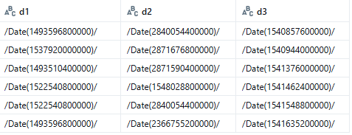

PySpark Interview Question: 27

